Slide 1

The Timely User Experience
CS 469 / CS 569: Special Topics in Computer Science: Human-Computer Interaction
Dr. Mohammed Ayoub Alaoui Mhamdi
Bishop's University
Sherbrooke, Qc, Canada
malaoui@ubishops.ca

Slide 2
The Timely User Experience
Topics
Introduction
Models of System Response Time (SRT) Impacts
Expectations and Attitudes
User Productivity and Variability in SRT
Frustrating Experiences

Slide 3
Introduction
With current computer, device, wireless and Internet technology, we have an increased thirst and expectation for fast response time
Loading graphics, audio, video, images, animation, etc. all impact how quickly we can do things (e.g. find directions, seek a restaurant review, send a video or image, etc.) in today’s society
Time is precious
Lengthy or unexpected system response time can produce:
Frustration
Annoyance
Eventual anger
Speedy and quickly done work can result in users:
Learning less
Reading with lower comprehension
Making more ill-considered decisions
Committing more data-entry errors

Slide 4
Introduction (concluded)
System Response Time (SRT) is a key topic and concern for network designers, wireless manufacturers, telecommunications providers, and others
There are steps interface designers can take to improve the timely user experience
Designers can optimize web pages to reduce byte counts and numbers of files or provide previews (e.g. thumbnails or coverage maps) to help reduce the number of queries and accesses to the network
Human reaction time is another factor
In practice, users do not seem to be bothered much by one-second delays in changing screens for PC applications and appear to tolerate somewhat longer times for websites to fully load

Slide 5
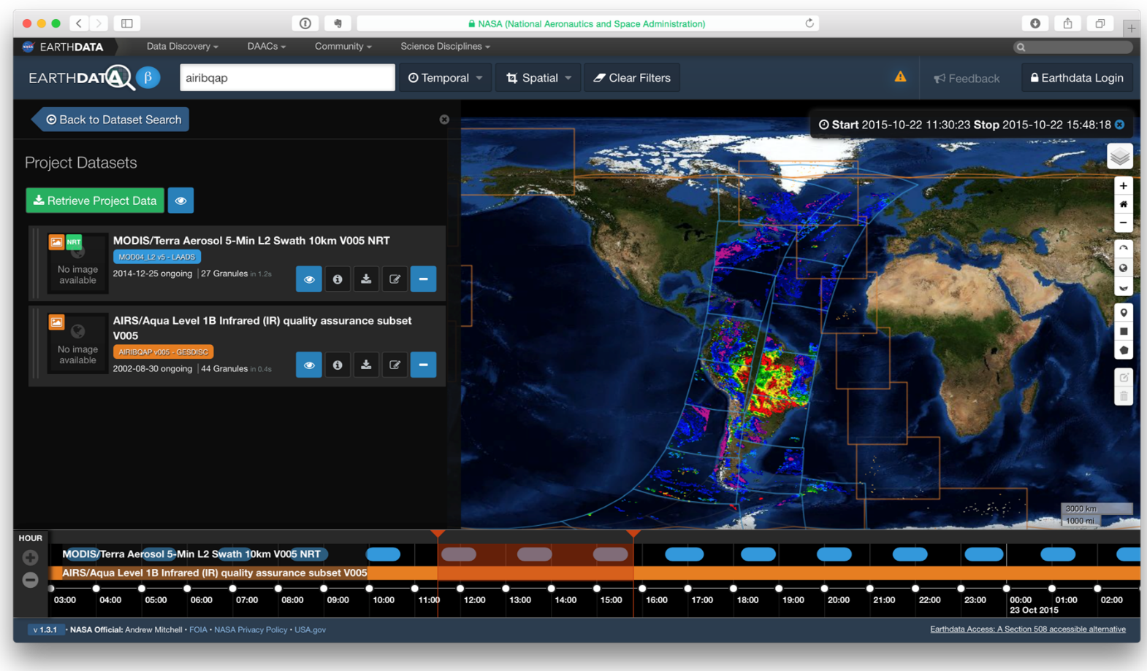
Optimizing Design (example)
The Earthdata Search (search.earthdata.nasa.gov) indicates the geographic and temporal coverage of datasets before the data is downloaded. Here the user has selected two datasets
The MODIS dataset is tagged with the color blue and the AIRS dataset orange
Those colors are used on the timelines and on the map revealing where and when the two datasets overlap
Providing previews of data availability helps users find what they need with fewer queries and network accesses
Notes:
Fig. 13.1

Slide 6
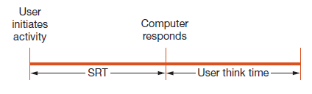
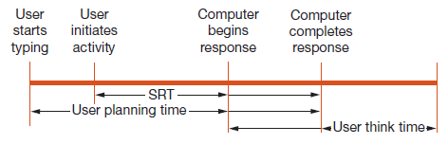
Models of SRT impacts
SRT definition:
The number of seconds it takes from the moment users initiate an activity until the computer presents results on the display
User think time:
The number of seconds the user thinks before entering the next action
Notes:
Fig. 13.2 and 13.3

Slide 7
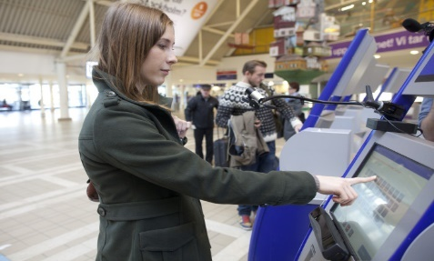
Models of SRT impacts (continued)
Designers of response times and display rates in HCI must consider:
Complex interaction of technical feasibility
Cost
Task complexity
User expectations
Speed of task performance
Error rates
Error handling procedures
Overall majority of users prefer rapid interactions
Lengthy response times (seconds) are detrimental to productivity
Rapid response times (1 second or less) are preferable, but can increase errors for complex tasks
Notes:
Fig. 5.4

Slide 8
Models of SRT impacts (concluded)
SRT has been investigated and analyzed for years
Many factors have been measured with the results sometimes debated (Dabrowski et al, 2011):
User accuracy and error rates with different levels of SRT
User performance speed and the efficiency of the commands used
How user interactions with the computer changed as a result of changes in SRT
How their bodies reacted physiologically to changes
How happy, satisfied, anxious or annoyed users were as SRTs changed

Slide 9
Expectations and Attitudes
Users may achieve rapid task performance, low error rates, and high satisfaction if the following criteria are met:
Users have adequate knowledge of the objects and actions necessary for the problem-solving task
The solution plan can be carried out without delays
Distractions are eliminated
User anxiety is low
There is accurate feedback about progress towards the solution
Errors can be avoided or, if they occur, can be handled easily
Three primary factors that influence user expectations and attitudes regarding SRT are:
Previous experiences
Individual personality differences
Task differences

Slide 10
Expectations and Attitudes (concluded)
These conjectures may play a role in choosing the optimum interaction speed:
Novices may exhibit better performance with somewhat slower response times.
Novices prefer to work at speeds slower than those chosen by knowledgeable, frequent users.
When there is little penalty for an error, users prefer to work more quickly.
When the task is familiar and easily comprehended, users prefer more rapid action.
If users have experienced rapid performance previously, they will expect and demand it in future situations.

Slide 11
User Productivity and Variability in SRT
Repetitive tasks
Nature of the task has a strong influence on whether changes in response time alter user productivity
Shorter response time means users responds more quickly, but decisions may not be optimal
Problem solving tasks
Users will adapt their work style to the response time
Users will change their work habits as the response time changes
People are willing to pay substantial amounts of money to reduce the variability in their lives, e. g. the insurance industry
Most people appreciate predictable behavior that lessens the anxiety of contemplating unpleasant surprises

Slide 12
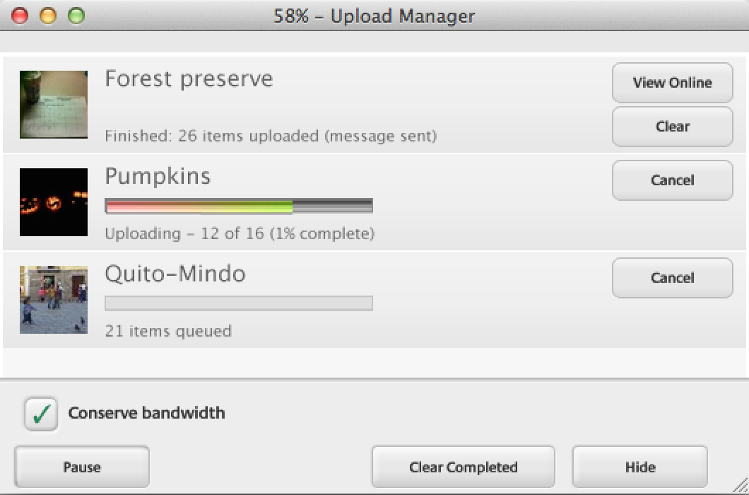
User Productivity and Variability in SRT (concluded)
Progress indicators reassure users that the process of uploading photos from Picasa to the web is underway, and how far it has gone already
They also allow users to see the results or to cancel uploads
Notes:
Fig. 13.4

Slide 13
Frustrating experiences
Since frustration, distractions, and interruptions can impede smooth progress, design strategies should enable users to maintain concentration.
Three initial strategies can reduce user frustration ☹
Reduce short-term and working memory load
Provide information abundant interfaces
Increase automaticity
Automaticity in this context is the processing of information (in response to stimuli) in a way that is automatic and involuntary, occurring without conscious control.
An example is when a user performs a complex sequence of actions with only a light cognitive load, like a driver following a familiar route to work with little apparent effort.

Slide 14
Reducing User Frustration
Increase server capacity, network speed, and network reliability
Improve user training, online help, and online documentation including tutorials
Redesign instructions and error messages
Continue the battle to stay ahead of the technology to protect users against spam, viruses, and pop-up advertisements
Organize consumer-protection groups
Increase research on user frustration
Catalyze public discussion to raise awareness

Slide 15
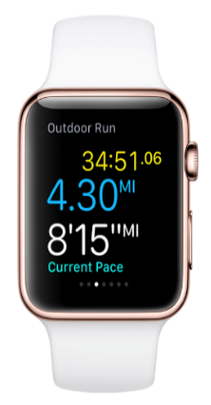
SRT Guidelines
Users prefer shorter response times
Longer response times (> 15 seconds) are disruptive
Users’ usage profiles change as a function of response time
Shorter response time leads to shorter user think time
A faster pace may increase productivity, but it may also increase error rates
Error-recovery ease and time influence optimal response time.
Response time should be appropriate to the task:
Typing, cursor motion, mouse selection: 50–150 milliseconds
Simple, frequent tasks: 1 second
Common tasks: 2 – 4 seconds
Complex tasks: 8 – 12 seconds
Notes:
Fig. 8.14

Slide 16
SRT Guidelines (concluded)
Users should be advised of long delays
Strive to have rapid start-ups
Modest variability in response time is acceptable
Unexpected delays may be disruptive
Offer users a choice in the pace of interaction
Empirical tests can help to set suitable response times

